Slide 1

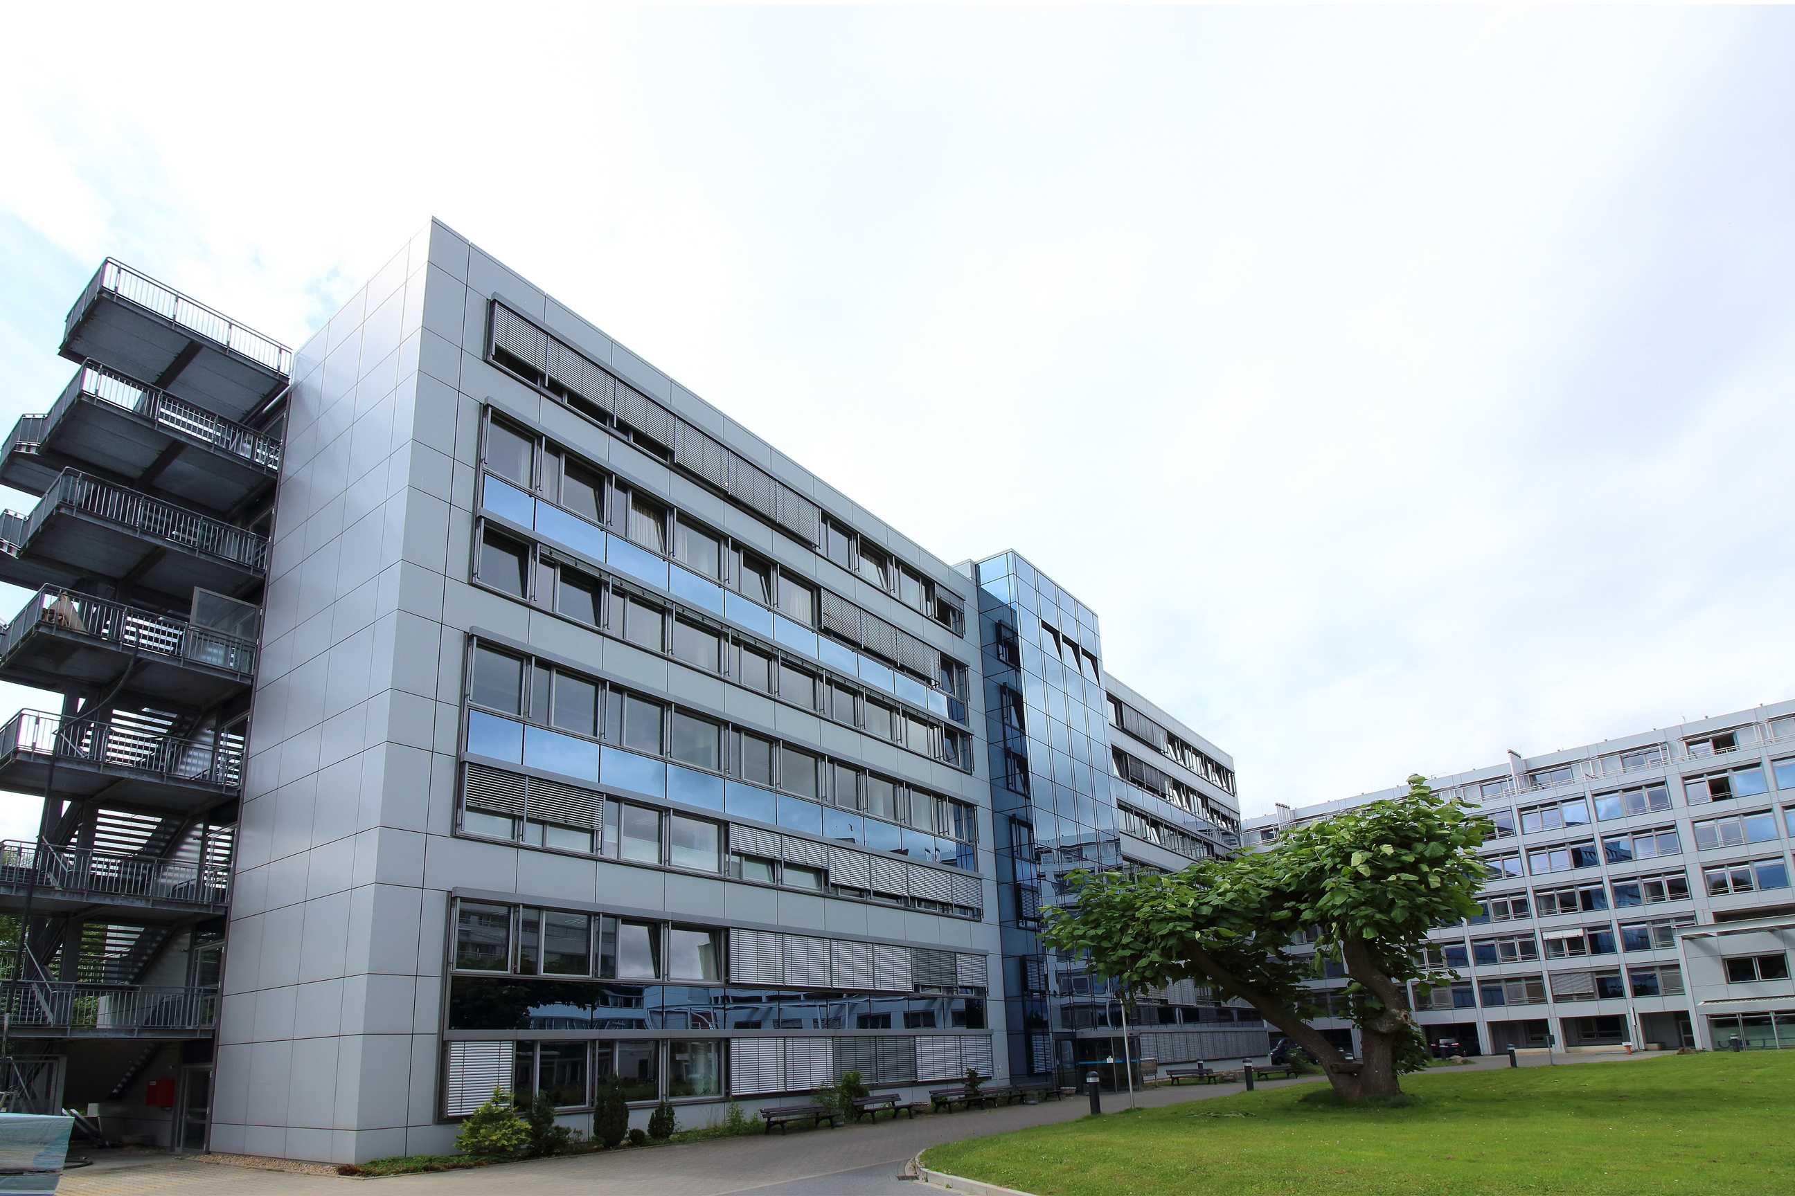


SQL Data Analysis
Presentation
on [] Hospital

Slide 2



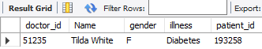

Hospital
Find all Doctors who have treated a patient for " Diabetes"
SELECT
d.doctor_id,
CONCAT(fname, ' ', lname) AS Name,
gender,
illness,
patient_id
FROM
doctor d
JOIN
worker w ON d.D_Worker_ID = w.Worker_ID
JOIN
diagnosis di ON d.Doctor_id = di.Doctor_ID
WHERE
Illness = 'Diabetes';

Slide 3

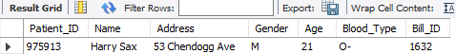
Hospital
Hospital
List the details of all patient who have been prescribed "B205"
SELECT
p.Patient_ID,
CONCAT(fname, ' ', lname) AS Name,
Address,
Gender,
Age,
Blood_Type,
Bill_ID
FROM
patient p
JOIN
medication_prescribed mp ON p.patient_id = mp.patient_id
JOIN
medication m ON mp.medication_id = m.medication_id
WHERE
m.Medication_ID = 'B205';

Slide 4

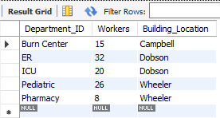
Hospital
Find the total numbers of workers in each dept
select * from department;

Slide 5

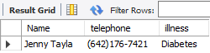
Hospital
Retrieve the names and phone numbers of all patient who have been diagnosed with " Diabetes"
SELECT
CONCAT(fname, ' ', lname) AS Name, p.telephone, illness
FROM
patient p
JOIN
diagnosis d ON p.Patient_ID = d.Patient_ID
WHERE
Illness = 'Diabetes';

Slide 6

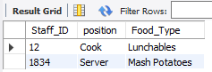
Hospital
List all cafeteria staff along with their job position and the food type served in their assigned cafeteria
SELECT
cs.Staff_ID,cs.position,c.Food_Type
FROM
cafeteria c
JOIN
cafeteria_staff cs ON c.Cafeteria_ID = cs.Cafeteria_ID
JOIN
staff s ON s.staff_id = cs.Staff_ID;

Slide 7

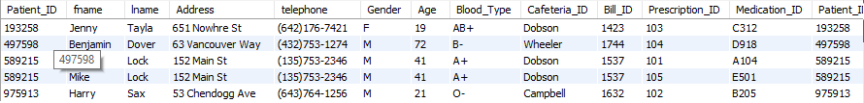
Hospital
Show details of patients along with the medication they are prescribed, even if no medication has been prescribed.
SELECT
*
FROM
patient p
JOIN
medication_prescribed mp ON p.Patient_ID = mp.Patient_ID;

Slide 8

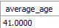
Hospital
Find the average age of patients diagnosed with 'Flu'
SELECT
avg(age) as average_age
FROM
patient p
JOIN
tests t on p.Patient_ID=t.patient_id where illness= 'Flu';

Slide 9

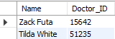
Hospital
Get names and ID for all Doctors who work in the 'ER' dept.
SELECT
CONCAT(fname, ' ', lname) AS Name,d.Doctor_ID
FROM
worker w
JOIN
doctor d ON w.Worker_ID = d.D_Worker_ID
JOIN
department de ON d.Department_ID = de.Department_ID
WHERE
d.department_ID = 'er';

Slide 10

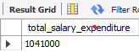
Hospital
Find the total salary expenditure for all workers
SELECT
SUM(salary) AS total_salary_expenditure
FROM
worker;

Slide 11
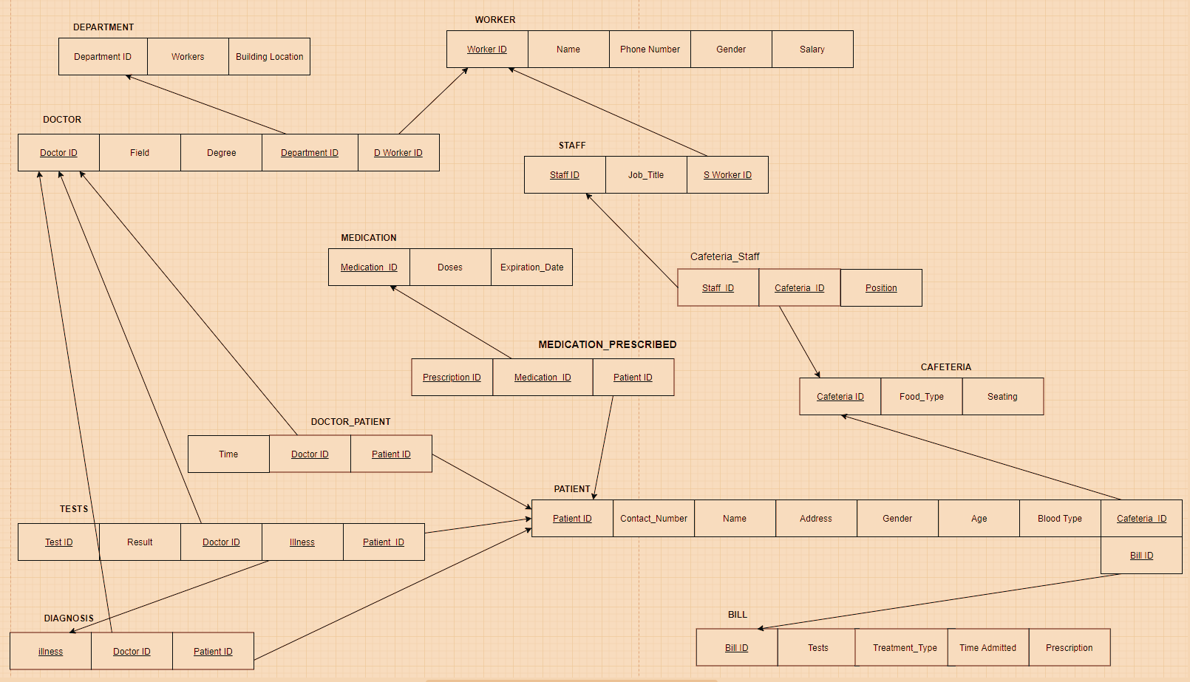

Hospital
EERD (Relational Model)
-
Anamitra Chakraborty

Slide 12

THANK YOU!

